Slide 1
Logo Design Tips for WordPress…and Beyond!
What makes a logo effective on the web and in print?
WORDCAMP ASHEVILLE | AUGUST 19, 2018

Slide 2
Hi – I’m Su Schaer
• I’m the owner of Nimble Design Team, a graphic design and WordPress website business located in Atlanta, GA.
• I love creating WordPress websites for clients.
• I’m very grateful for the Atlanta WordPress community!
#wcatl
@NimbleDesignATL
@wordcampatl

Slide 3
Why have a logo?
What is a logo, anyway?
Logo vs. Branding vs. Brand Identity

Slide 4
Logo: a graphic symbol that represents the essence of a person, company or organization.
• A logo is symbolic artwork
• A crisp, clear and professional logo on your website conveys credibility and authority
• Establishes your business or organization as a high-quality, trustworthy entity and offers reassurance that visiting your site will be worthwhile

Slide 5
Brand identity: a combination of
how you define and promote yourself, and how others see you.
• Your logo is one (very important) element, of your organization's brand identity
• Everything you do to build awareness and reputation around your company and its product or services creates branding
• Brand identity is the collection of your business assets, including the logo, which helps to create your brand image

Slide 6
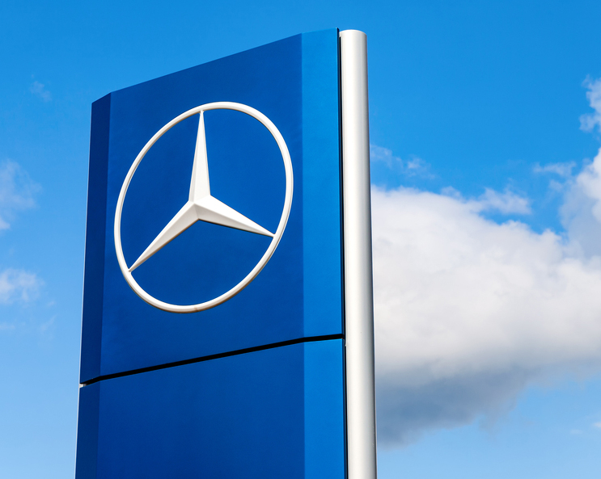
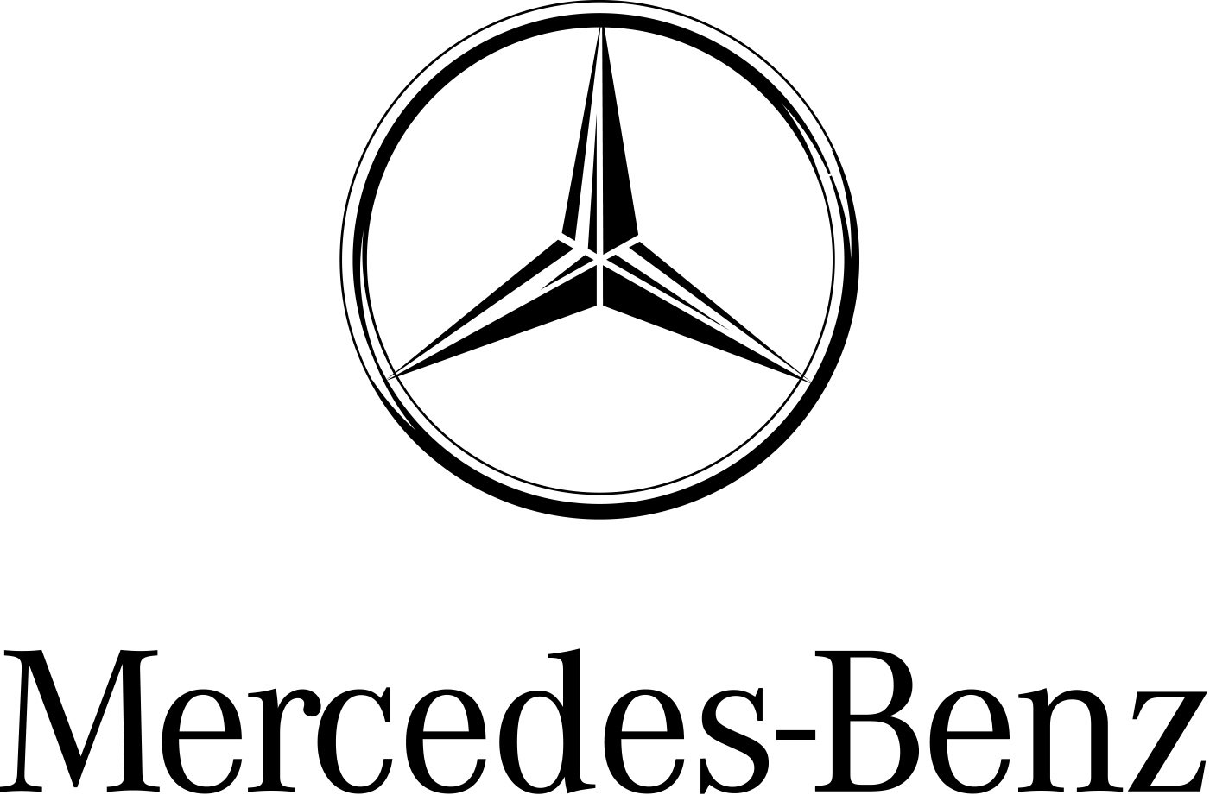
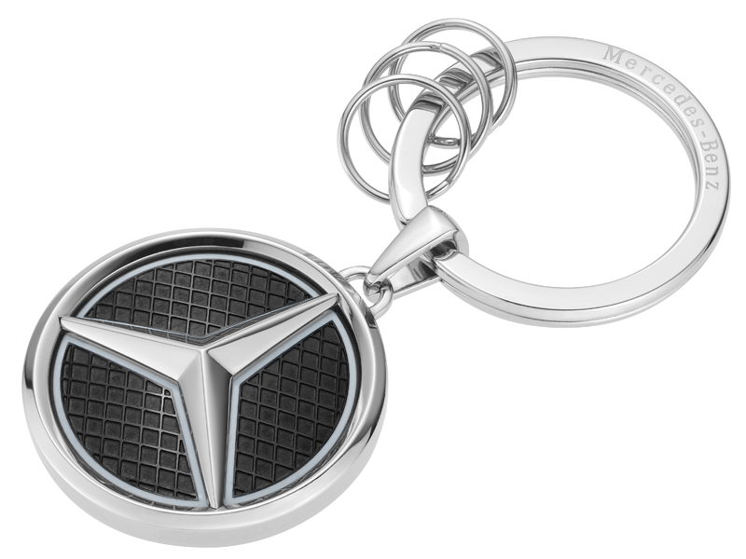
Example of consistent use of a well-designed logo

Slide 7
Be consistent.
• When building brand recognition, you will confuse your audience if you use different logo versions.
• Consistent colors, typefaces and shapes help your potential clients to remember your business, and forges a connection.
• People are more likely to choose brands that are familiar, because they seem established, and therefore trustworthy.

Slide 8
A strong logo should do the following:
1. Embody your brand
2 . Be instantly recognizable
3 . Be versatile
4 . Be timeless

Slide 9
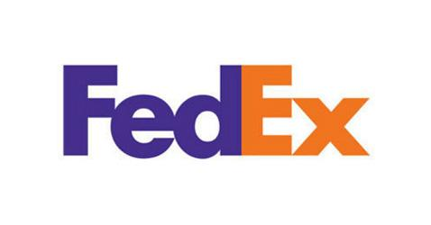
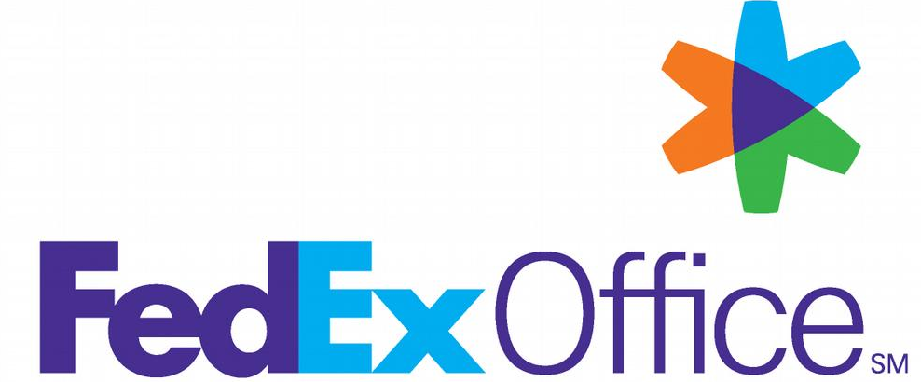
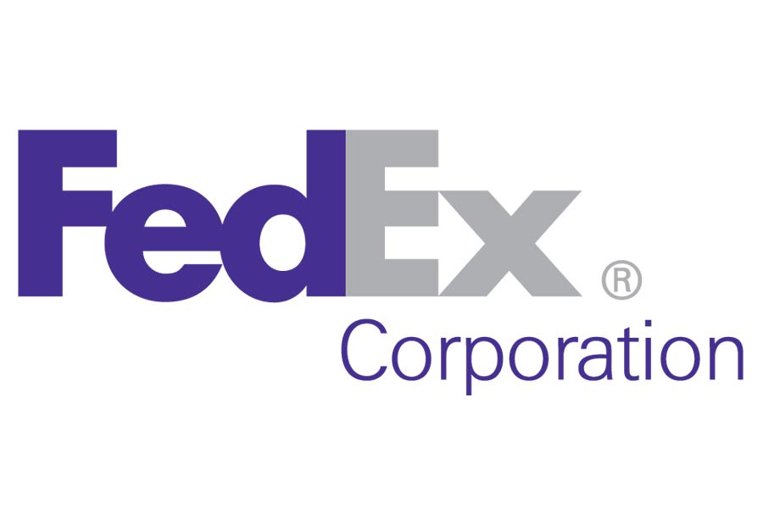
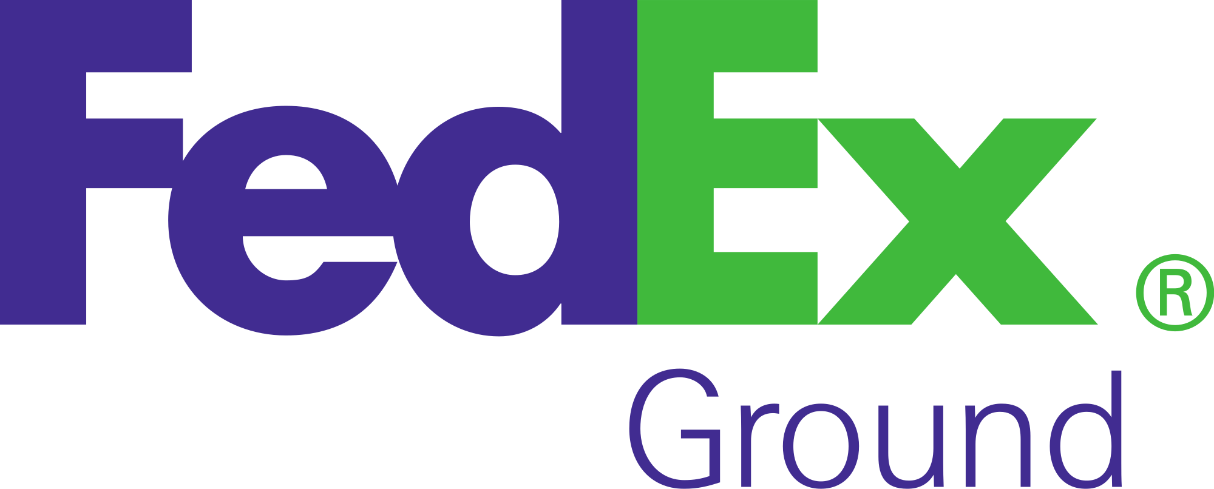

Slide 10
What are the key elements of an effective logo?
• Typography
• Color
• Imagery

Slide 11
What are the key elements of an effective logo?
• Typography
• Color
• Imagery

Slide 12
A logo can be purely typographic, or include a visual element.
• A logotype or wordmark is where only the letters of the name make up to the logo (no additional symbols).
• The lettering itself becomes the visual.

Slide 13
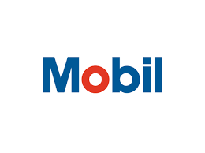
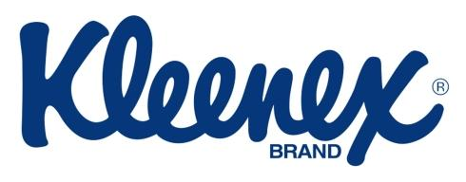
.
.

Slide 14
A logomark combines a visual element along with the business name.

Slide 15
.
.

Slide 16
How about not having any typography at all?

Slide 17
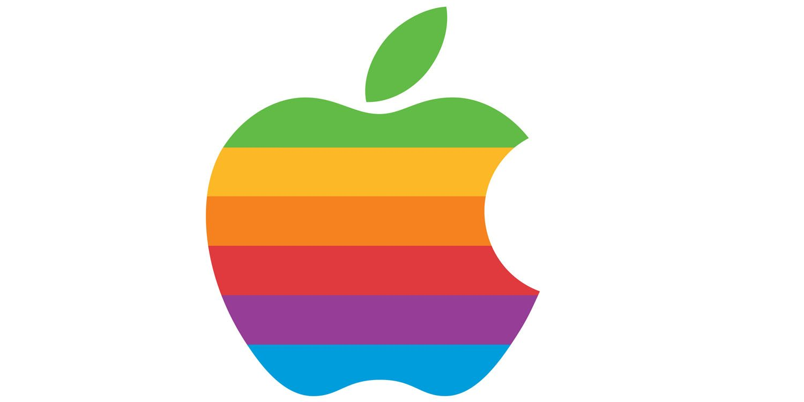
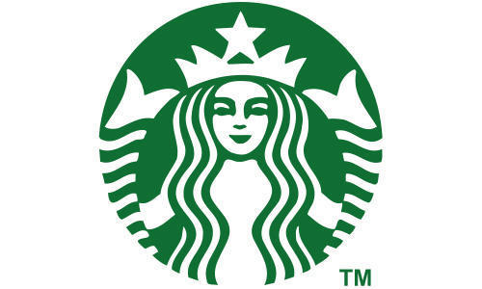
Some logos need no words.
.
.

Slide 18
A logo can tell a story.
• NBC (originally known as the Peacock Network) used an illustration of a stylized peacock in its 1956 logo.
• The peacock became a marketing tool that was used in the hope NBC viewers would purchase color TV sets.
• Over the years, the peacock evolved into a new shape.

Slide 19
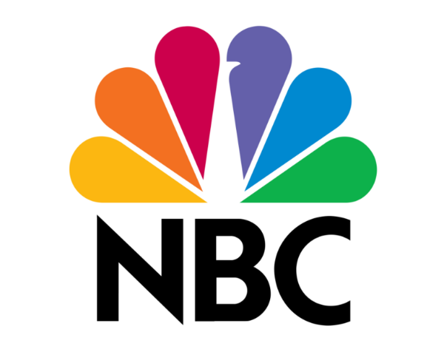
“Brought to you in living color”
.
.

Slide 20
What are the key elements of an effective logo?
• Typography
• Color
• Imagery

Slide 21
Create a consistent color palette.
• Consistent use of your logo colors should be part of your overall branding strategy, across all media.
• Does the client have existing corporate colors, or a branding guide that you need to follow?

Slide 22
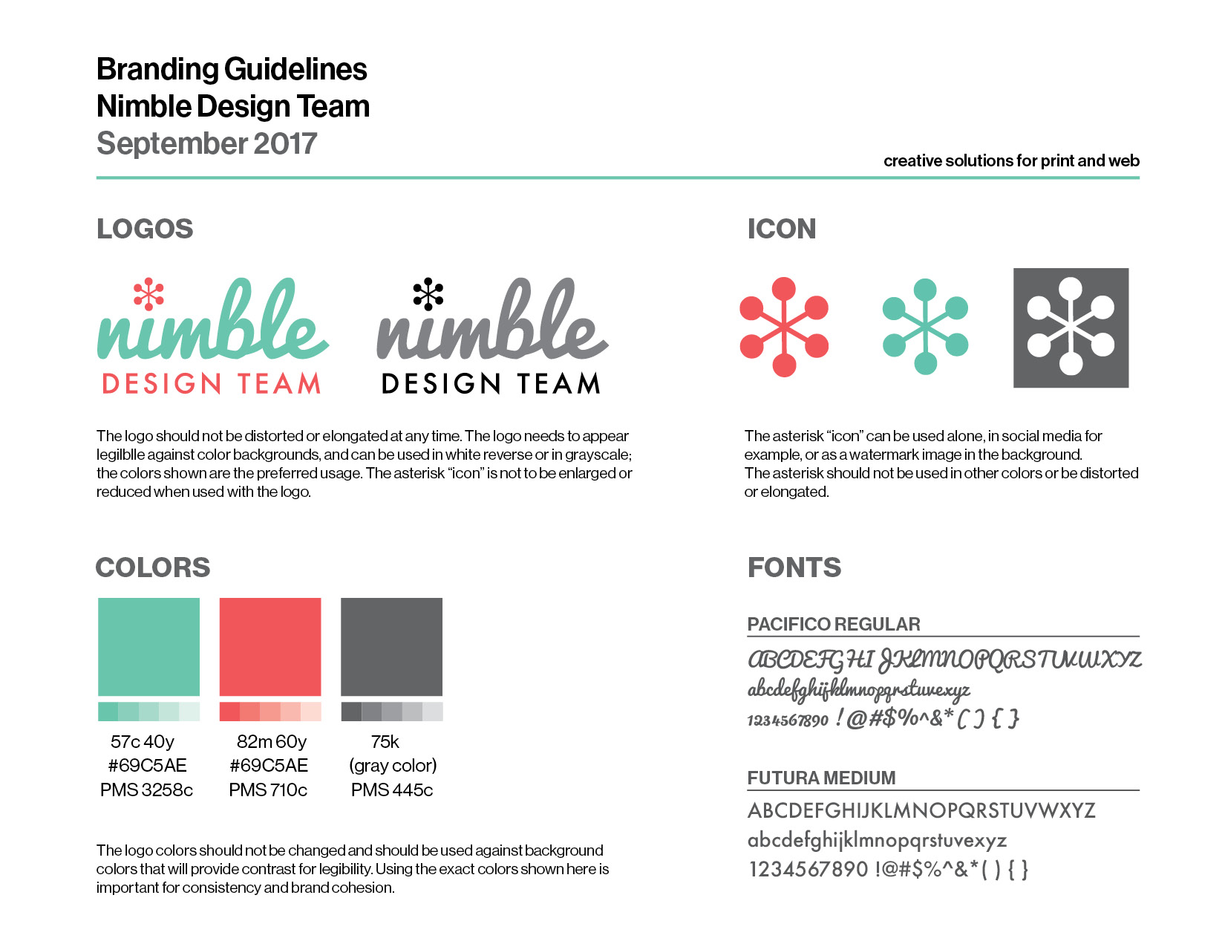
Example of a simple logo branding guidelines sheet
.

Slide 23
Color trends vary.
Certain color schemes look dated today but were hip & trendy once. Colors can really “age” a logo.

Slide 24
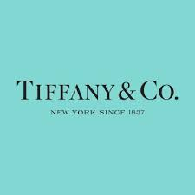
Dated
Timeless
.
.

Slide 25
Color is powerful.
Color is subjective.
• Colors that might work well in North America can have a radically different meaning in other cultures.
• Even in a global economy, color associations can vary.

Slide 26
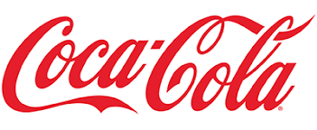
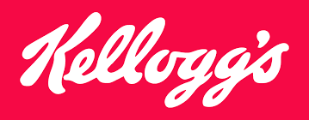
Red implies passion, energy, and danger; it can also convey warmth and heat.
.
.

Slide 27
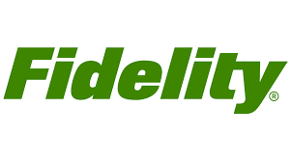
Green implies fresh, ethical, growth. Popular with financial products, too.
.
.

Slide 28
Blue implies professionalism, trust, integrity, sincerity and calm, and is one of the most widely used colors in corporate logos.
.
.

Slide 29
Single color or two-color palettes are best…but not always *
*There are some very successful multi-colored logos.

Slide 30
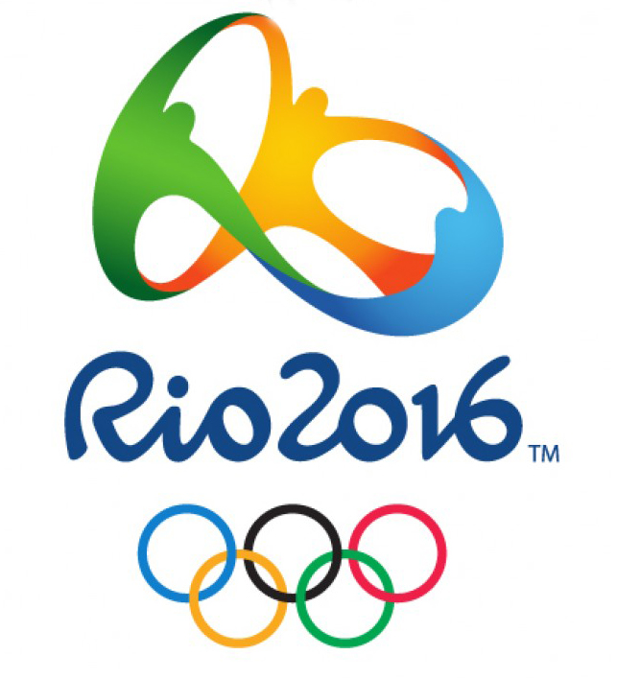
These companies offer a diverse selection of products and services. The multi-color scheme used for the Olympic rings suggests diversity and inclusivity.
Learn how to do things that aren’t in your normal toolkit, such as:
CSS editing (to customize theme)
Migrating websites
Creating backups
Formatting basic SEO

Slide 31
What are the key elements of an effective logo?
• Typography
• Color
• Imagery

Slide 32
On selecting imagery
• Go for non-generic, memorable elements that communicate your business “personality”
• Readability is key - for instant recognition and clarity
• “Icon” style images are useful for social media

Slide 33
Current trends in logo design
• Unusual typefaces
• Geometric shapes
• Social-media ready
• Bright, flat colors
• Gradient color and overlays

Slide 34
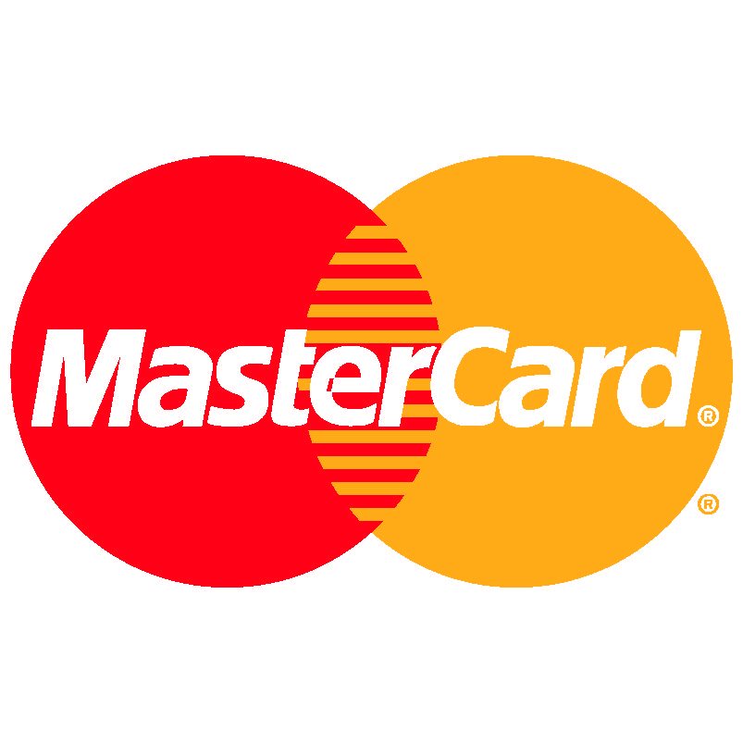
Logos that have been redesigned to look better on social media
“Before” versions
.
.

Slide 35
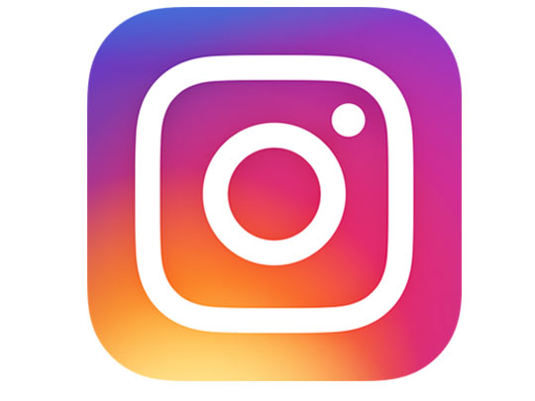
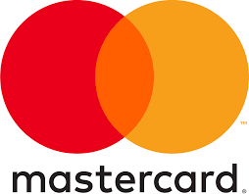
Logos that have been redesigned to look better on social media
.
.

Slide 36
Don’t do this!
• Poor quality, overused clip art
• Poor quality or illegible typefaces
• “Free” art (always check on copyright limitations)
• Generic “canned” logos can look cheap, unprofessional

Slide 37
Clip art that your client found for free in Microsoft Word does not qualify as a “logo.”

Slide 38
Help your logo work well on the web:
• Echo colors, typeface on site; option to use logo typeface with accent headlines, etc.
• Connect visually and use same logo colors on your social media and print materials as well.
• Consistency!

Slide 39
Where should the logo appear on your website?
• The header of any website (where visitors will likely first see your logo) is a strategically important piece of real estate and interaction.
• Users are 89% more likely to remember logos shown in the traditional, top-left position over logos placed on the right.

Slide 40
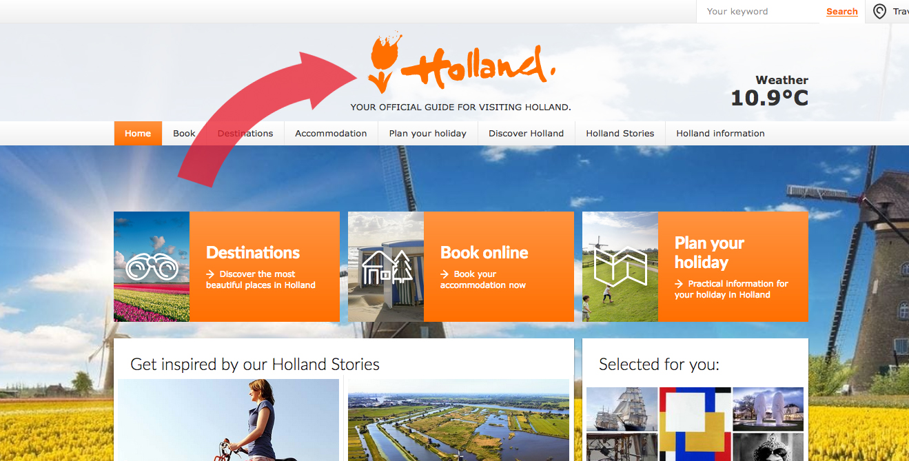
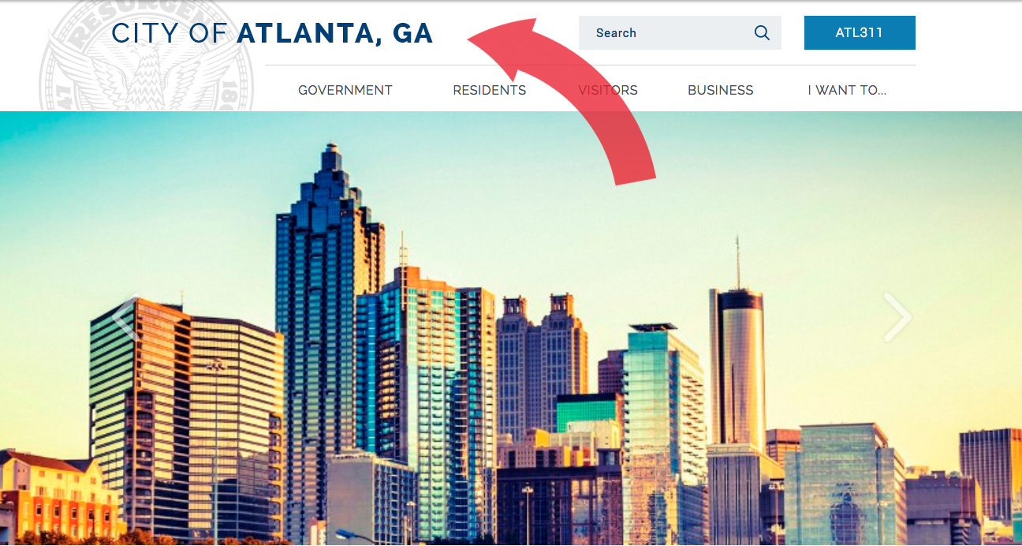
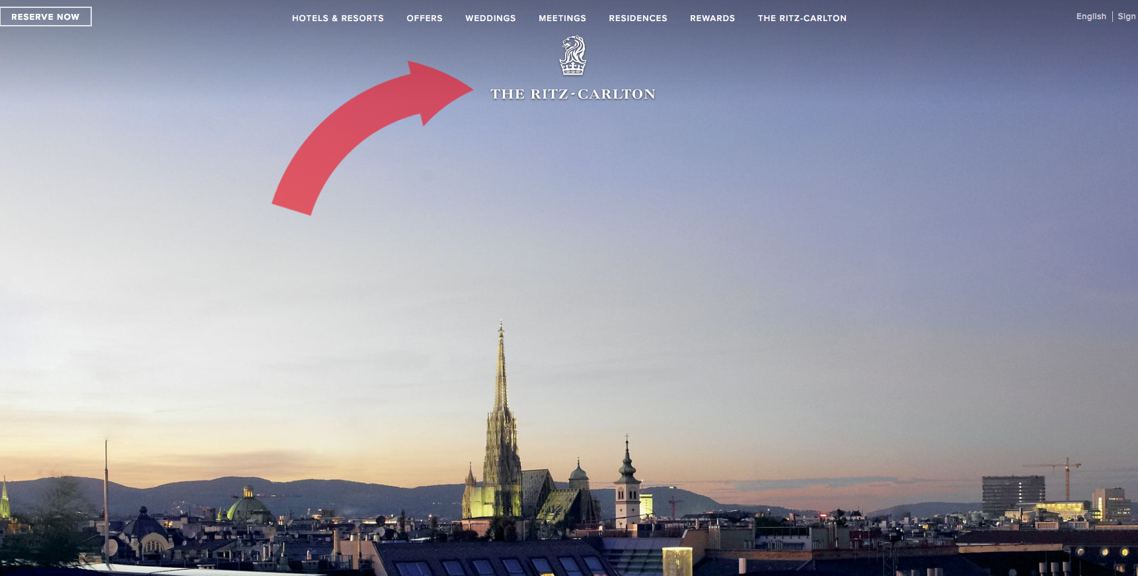

Slide 41
Centered logos and mobile devices
• Centered logos appear more often on websites, likely because of responsive and “mobile-first” designs.
• Mobile designs often use the top-left corner to display a menu icon, and then shift the logo towards the center of the screen.

Slide 42
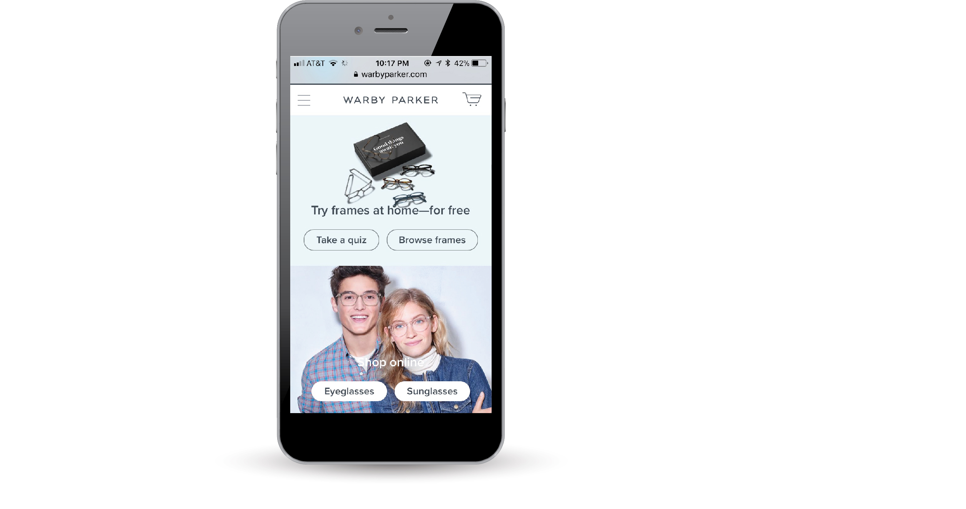

Slide 43
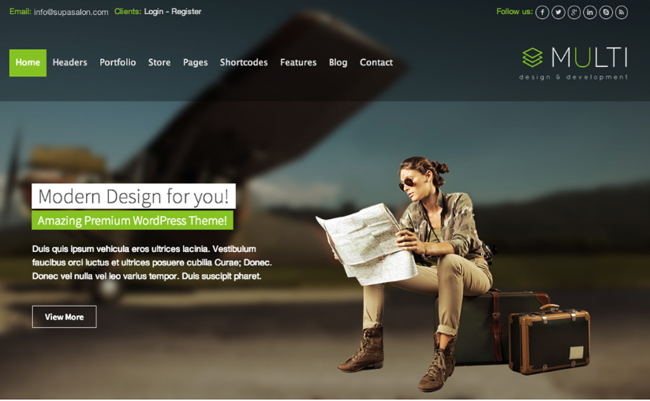

Slide 44
The dreaded request: Can We Make the Logo Bigger?
Bigger is definitely not better.

Slide 45
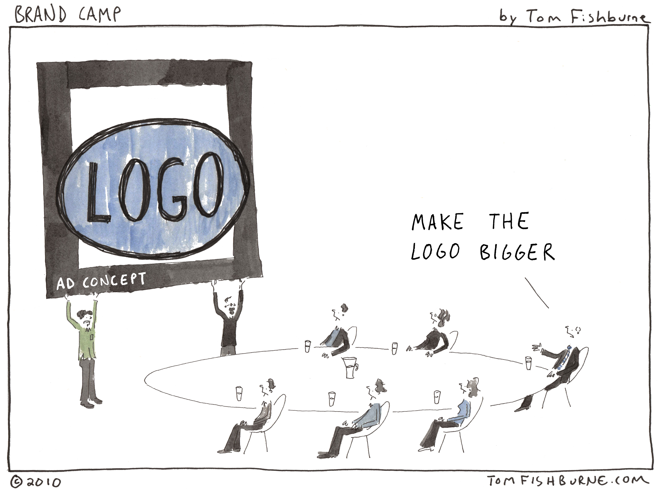

Slide 46
Logo shape options: be flexible and create different versions
• Many companies use a single letter or graphic element from their logo for social media purposes.
• An uncomplicated logo with just a few colors will stand out better online.
• Logos need to adapt to various formats and usages.

Slide 47
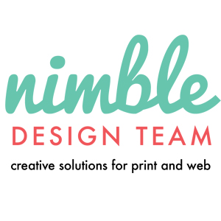
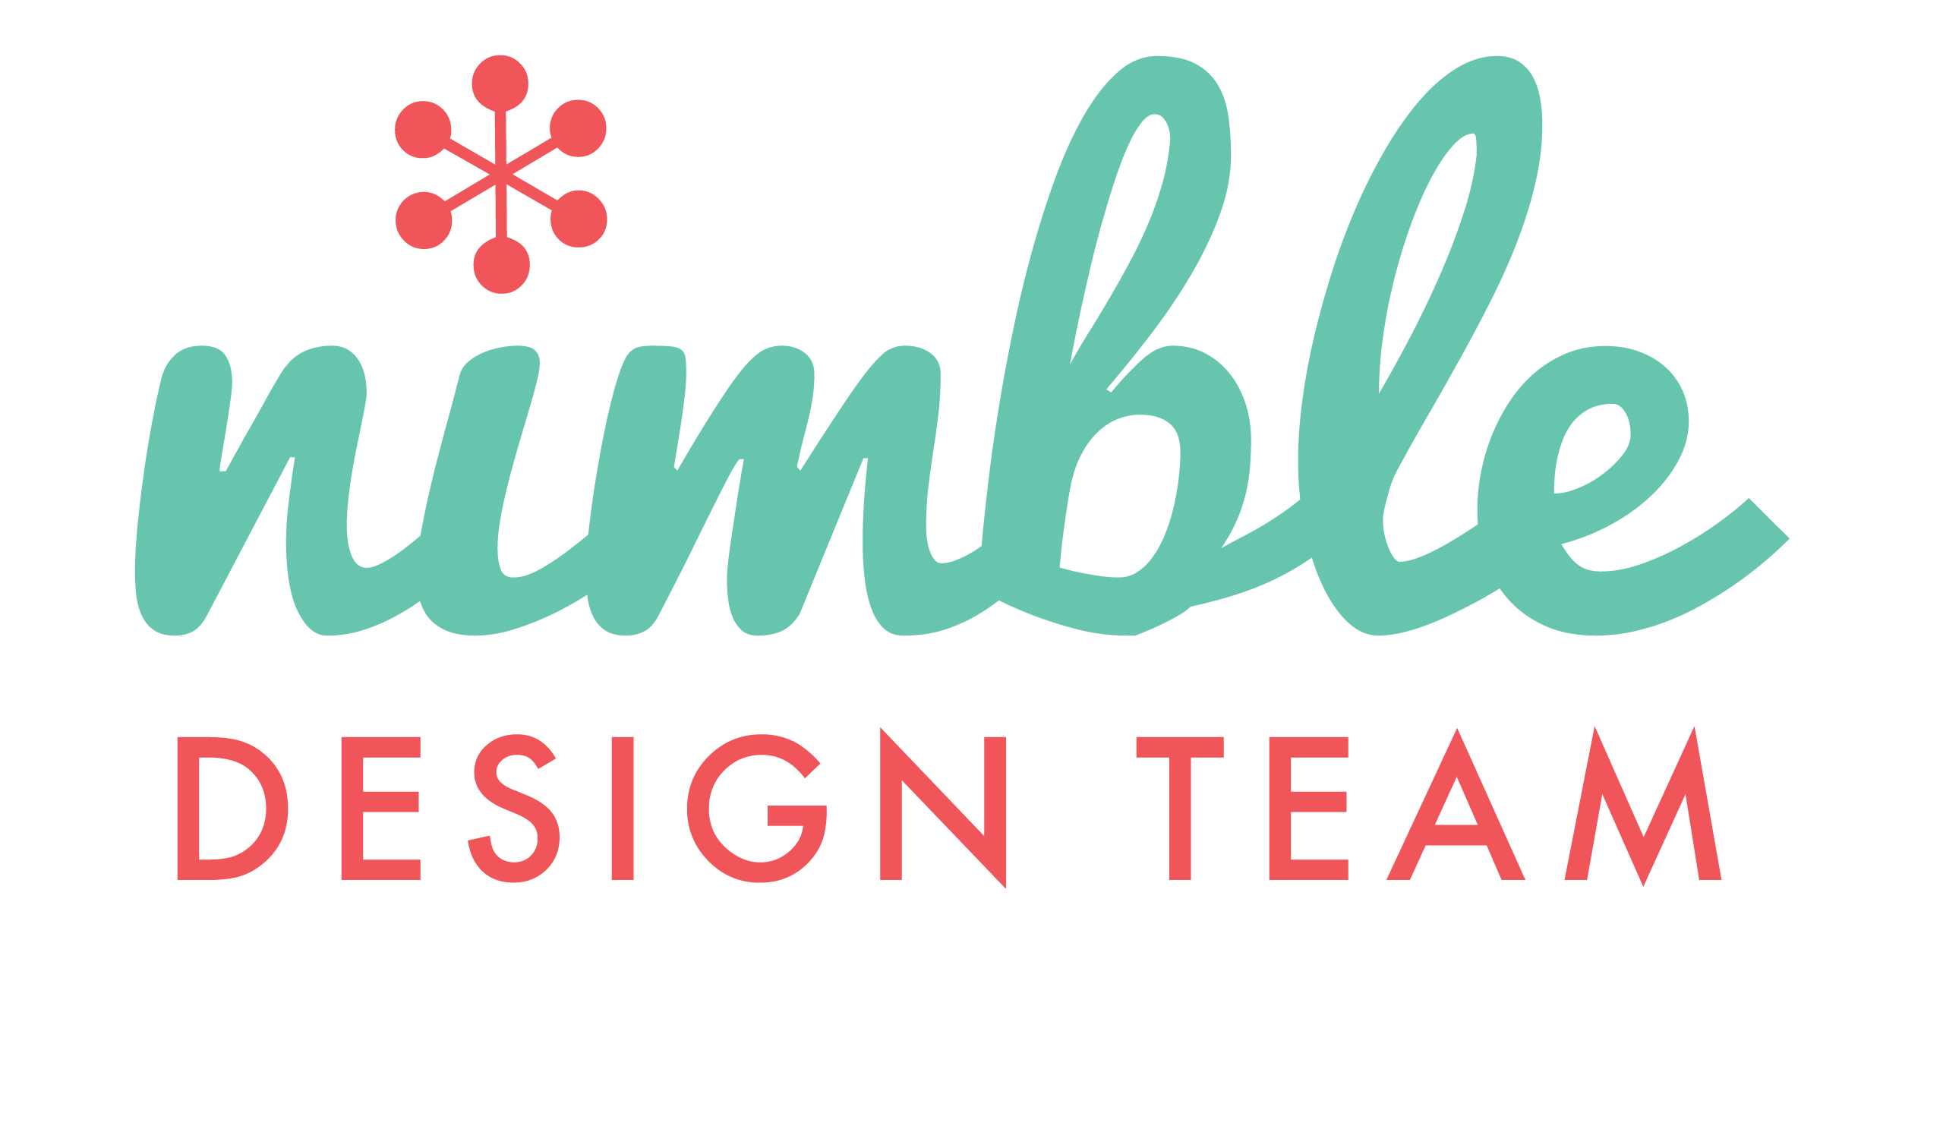

Slide 48
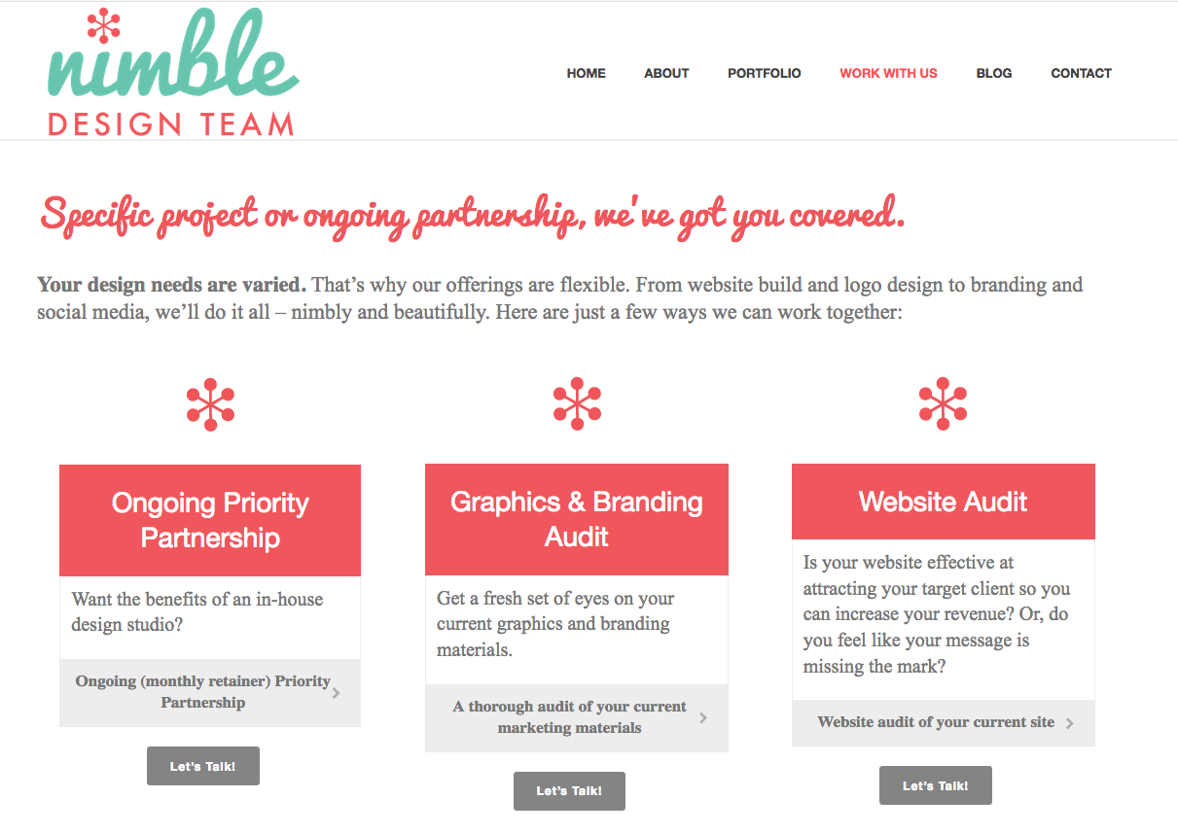

Slide 49
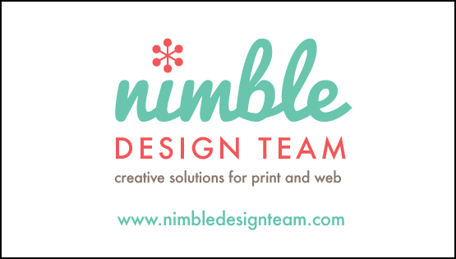

Slide 50
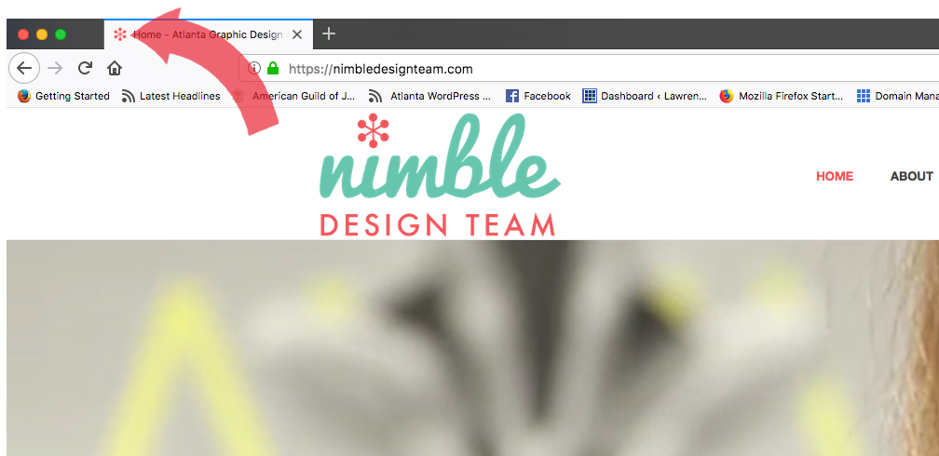
The small but mighty favicon!

Slide 51
Best practices for logo file creation:
• Create logo file as vector art (.ai file) in Adobe Illustrator, so it can be sized as large as you like and not lose resolution
• When you create your logo in Adobe Illustrator you can set up colors for the various file formats and usages you’ll need

Slide 52
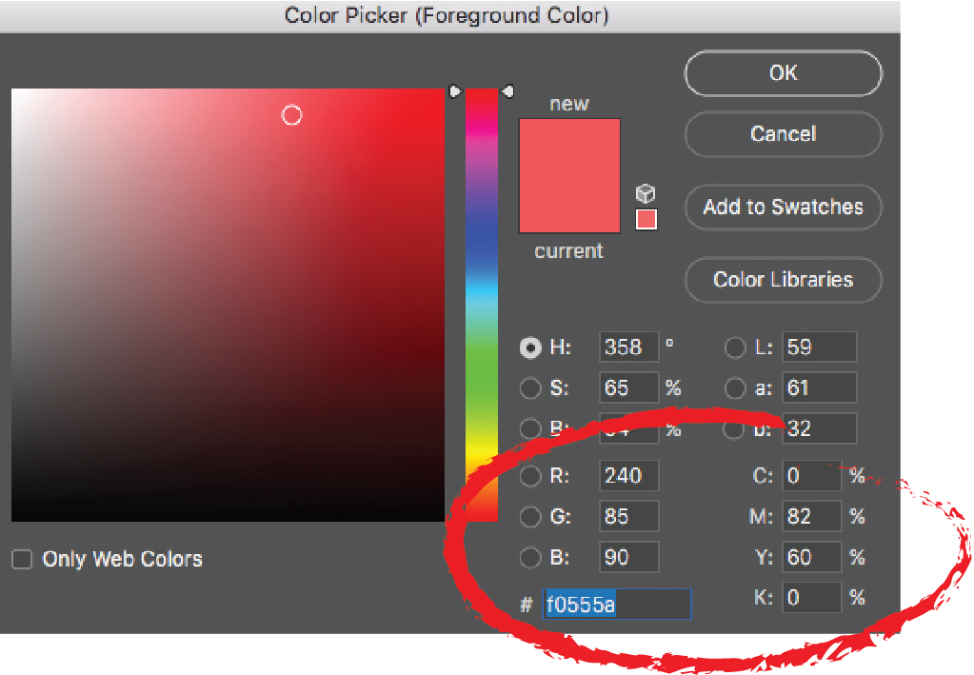
Logo colors may vary, depending on file format

Slide 53
Thank You!

Slide 54
Please see me for a “quickie” logo review, at the Happiness Bar
…and grab my handy Branding Audit Checklist handout!
< Please sign up for my email newsletter >

Slide 55
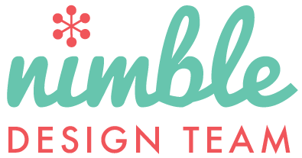
Su Schaer
404-226-2919
su@nimbledesignteam.com www.nimbledesignteam.com
@NimbleDesignATL

